Slide 1


Data Analytics Lifecycle
Notes:
A data analytics project consists of several tasks that can be divided into a number of logical iterative phases. This presentation, explains these phases and discuss the tasks and considerations for each step.

Slide 2
Key Roles in Data Analytics Projects
Project Sponsor: Responsible for the genesis of the project, provides impetus for the project and usually provides funding as well.
Business User/Analyst: Has a deep understanding of the business domain and is likely to use the end result of the project once implemented.
Data Engineer: Deep technical skills to work with databases and can assist providing access to right data sources.
Notes:
Before start explaining different steps of a typical analytics project, let us introduce some of the key roles involved in a data analytics project. Although there might be several stakeholders involved in a project, there are three key roles that you, as a data scientist or analyst, would most likely interact with during a project. This includes the project sponsor, the data analyst, and the data engineer.
The project sponsor is the person who is responsible for the project and usually provides the funding for the project. He or she defines the expectations. The business analyst or the business user is the one who has a very deep understanding of the business domain and is very likely that the model that you are developing is used by her.
A data engineer has a good understanding of the data resources within the organization and can help you get access to the data. In the next few slides, we will see how these individuals are engaged in various stages of an analytics project.

Slide 3




Data Analytics Lifecycle: Overview
Operation
Discovery
06
01
Communication
05
02
Data Prep
04
03
Model Building
Model Planning
Notes:
This slide shows various steps involved in a life cycle of a typical data analytics project. As you can see, there are six logical steps involved in a project. First is the discovery phase where the project is defined including defining the expectations, the scope, the timeline and resources needed to complete the project. At this phase, the project sponsor, the business analysand the data engineer should be engaged to ensure that the scope of the project is clear, and the project is feasible considering the data and other resources available at the organization. The next step is data preparation, where the relevant sources of data need to be identified and the data needs to be prepared. The business analyst can help to identify the potentially useful data sources while the data engineer can help to get access to the data. Once the data is ready for the modeling, potential appropriate modeling approaches should be shortlisted. Subsequently, analytical models will be implemented, optimized and tested. After that, the business insights from the model should be identified and communicated to the project sponsor and the data analysts. Finally, necessary actions should be taken to operationalize the model in the organization. This, of course, may require the help and insights from both the business analyst and data engineer. Now we will discuss each of these steps in more details.
https://www.presentationgo.com/presentation/cycle-diagram-powerpoint/

Slide 4
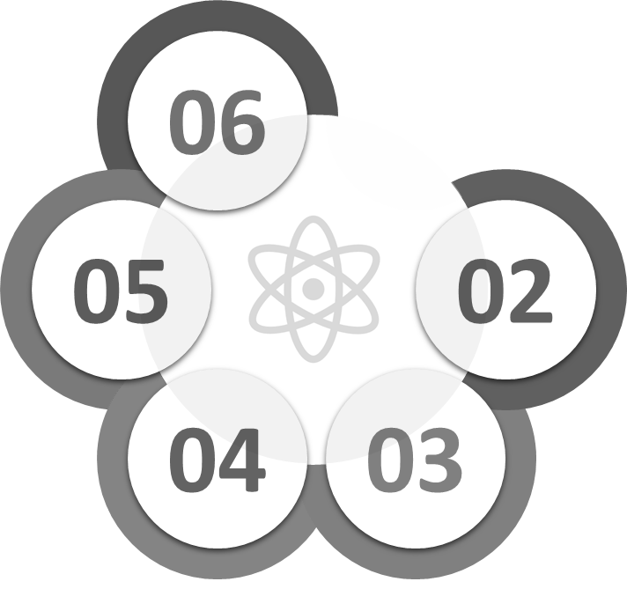
Step 1: Discovery
Operation
Discovery
06
01
Communication
05
02
Data Prep
04
03
Model Building
Model Planning
Notes:
Pause for 10 seconds

Slide 5
Step 1: Discovery
Understand and formulate the business problem
Articulate the pain points as clearly as possible so you can make sure to address them
Define and formalize the scope of the project
Identify the kinds of data you will need to solve the problem
Determine the resources that you may need during the project (Infrastructure, Software, Data access, Business experts, etc.)
Notes:
So the first step of the project is the discovery phase where you need to understand and formulate the business problem. This includes understanding exactly what the business is suffering from and what they're hoping to achieve by the end of the project.
You should also assess the resources available to support the project in terms of people, technology, time, and data. Important activities in this phase include framing the business problem as an analytics challenge that can be addressed in subsequent phases as well as formulating initial hypotheses to test.

Slide 6
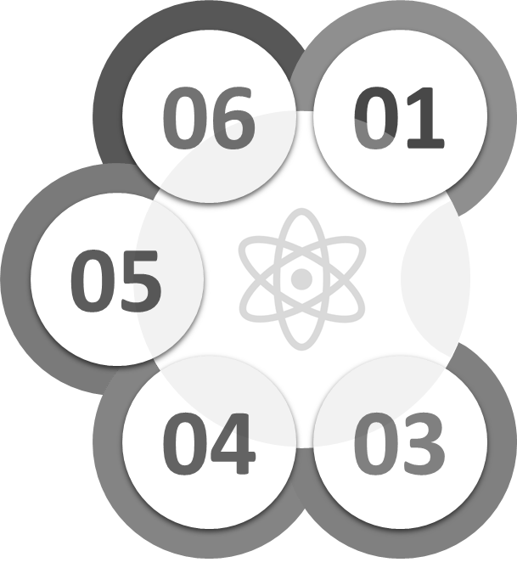
Step 2: Data Preparation
Operation
Discovery
06
01
Communication
05
02
Data Prep
04
03
Model Building
Model Planning
Notes:
Pause for 10 seconds
https://www.presentationgo.com/presentation/cycle-diagram-powerpoint/

Slide 7
“By failing to prepare, you are preparing to fail.” Benjamin Franklin
In predictive analytics, various algorithms are deployed to mine data to find patterns with the goal making predictions.
Predictive analytics systems deploy more complex algorithms and are more computationally intensive
In Predictive Analytics systems the focus is in predicting the future as opposed to describing what has happened in the past which is the focous of BI systems.
Notes:
Pause for 10 seconds

Slide 8
Step 2: Data Preparation
Of all of the phases, the step of data preparation is generally the most iterative and time intensive.
Prepare an analytic sandbox, in which you can work for the duration of the project.
Extract data from different platforms into your analytics sandbox. You should be collecting all kinds of data that is available.
Clean the data and apply relevant transformation
Notes:
Once you have a clear idea about the scope of the project and available resources, you can move to the next step which is data preparation. This phase includes steps to explore, preprocess, and condition the data.
Data preparation tends to be the most labor-intensive step in the analytics lifecycle and often takes more than 50% of the project time. This is because this phase is very iterative and therefore is underestimated in many projects.
During the data preparation phase, you may want to use a robust environment which is called analytics sandbox to import data from different sources and perform necessary preparation steps such as merging dataset and cleaning the data. These steps are discussed with at more details later in the course.

Slide 9
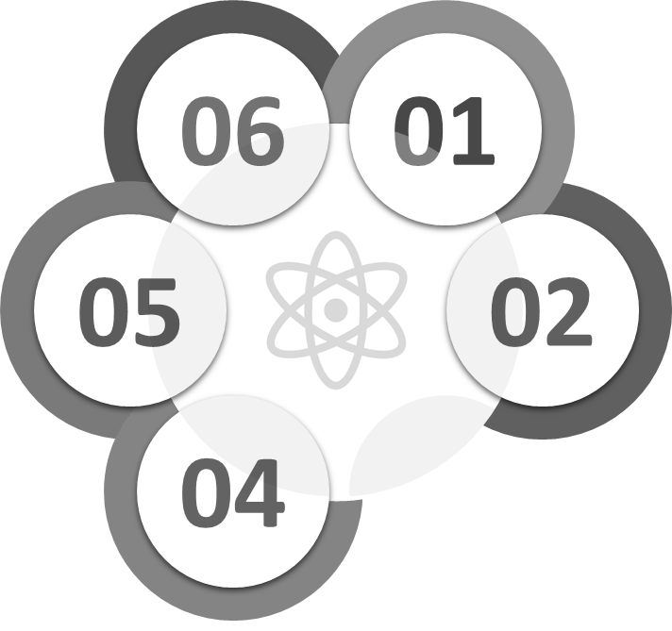
Step 3: Model Planning
Operation
Discovery
06
01
Communication
05
02
Data Prep
04
03
Model Building
Model Planning
Notes:
Pause for 6 seconds

Slide 10
Step 3: Model Planning
Model Planning
Model Selection
Variable Generation /Selection
Notes:
Once you are satisfied with the quality and coverage of your input data, you can move to the next phase which is model planning. This phase consists of two sub-steps: Variable Generation and selection, and model selection.

Slide 11
Model Planning: Variable Generation/Selection
Variable Generation: Generate new variables by modifying/combining existing variables, as needed, and then select a subset of relevant variables for model building.
Why Variable Selection/Filtering?
Improved model building process and computation speed
Improved model’s explainability
Cost considerations (e.g. may need to pay for external data sources)
Legal and policy considerations (e.g. using demographic information for credit scoring)
Improved model accuracy (in some cases)
Notes:
So let's discuss the variable generation and variable selection. As the name implies, variable generation involves creating new variables by modifying or combining different variables from the original data.
This is useful because in some cases the engineered variables have more predictive power than the original ones.
For examples, various ratios that can be constructed by dividing one variable by another one are very common in modelling. Transformations such as normalization or applying logarithmic operations on the variables are other examples. Sometimes similar functions are performed in the data preparation phase as well.
Variable selection, on the other hand, deals with selecting a subset of variables that are more relevant to the modeling task as opposed to including all variables in the model.
There are many reasons as to why variable selection can be useful. For example, variable selection can improve the speed of model building by excluding irrelevant variables. Also, with fewer variables, the resulting model is likely to be easier to be interpreted and explained.
Plus, in some cases you may have to pay for some data sources. In that case, it makes sense to exclude variables that are not contributing to the model. Also, depending on the application, you may not be allowed to use all type of variables. For example, a bank can not use demographic information such as the race to approve or decline the loan application of a customer. Removing irrelevant variables can also result in improved accuracy of the model in some cases.

Slide 12
Model Planning: Model Selection
What it is? There exist a large number of analytics algorithm. Choosing the right algorithm for the given problem is key.
What to Consider?
Feasibility of applying the algorithm
Accuracy of the algorithm
Explainability of the algorithm
Computational complexity of the algorithm
Recommendation
Always start with simpler algorithms (e.g. linear models)
Notes:
Model selection, on the other hand, involves evaluating the suitability of a range of algorithms for the given modeling task.
In doing so, we should consider the feasibility of applying a particular algorithm, the expected accuracy of using that algorithm, and the transparency of the algorithm.
The transparency of the algorithm defines how easy it is to explain the model’s logic once it is constructed. Computational complexity is another important consideration. In general, it is recommended to start by using a simple model that is easy to understand and to use a more sophisticated model only if needed.
Generally speaking, linear models are simple and easy to understand.

Slide 13
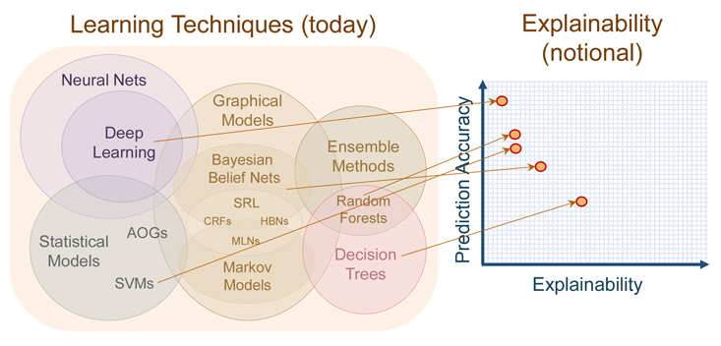
Model Planning: Model Selection
Notes:
This slide illustrates the trade-offs between the transparency and accuracy for a number of modeling algorithms. As it is shown unfortunately the models such as deep neural networks that are more accurate are also more difficult to interpret. On the other hand, more transparent models such as decision trees may not be as performant compared to more sophisticated methods. It is still highly recommended that you start with a simpler model as their accuracy would still be sufficient for many business applications. In addition, once a model is constructed you can always upgrade it if the requirements for the accuracy changes over the time.

Slide 14
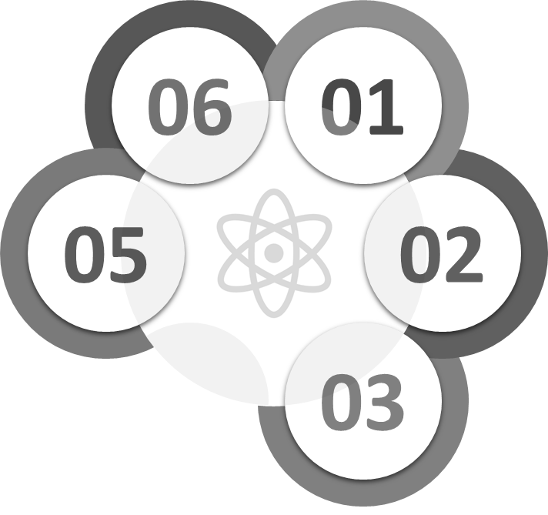
Step 4: Model Building
Operation
Discovery
06
01
Communication
05
02
Data Prep
04
03
Model Building
Model Planning
Notes:
Pause for 6 seconds
https://www.presentationgo.com/presentation/cycle-diagram-powerpoint/

Slide 15
Step 4: Model Building
Implement the model using the appropriate programming language/tool (R, Python, SAS, SPPS, etc.)
Fine tune the models to optimize the results
Construct a list of key variables (variable importance scores)
Assess the validity of the model and its results
Record the results, and logic of the model
Notes:
The next step after model planning is a model building where the modeling algorithm is implemented using appropriate programming languages or tools such as R, Pythons, SPSS, SAS or other tools. Most modeling algorithms have some parameters that should be optimized. Optimization of relevant parameters can significantly affect the performance of a model. Once the model is optimized you need to validate the performance of the model to make sure that the model is stable. These steps will be discussed in more details later in the course.

Slide 16
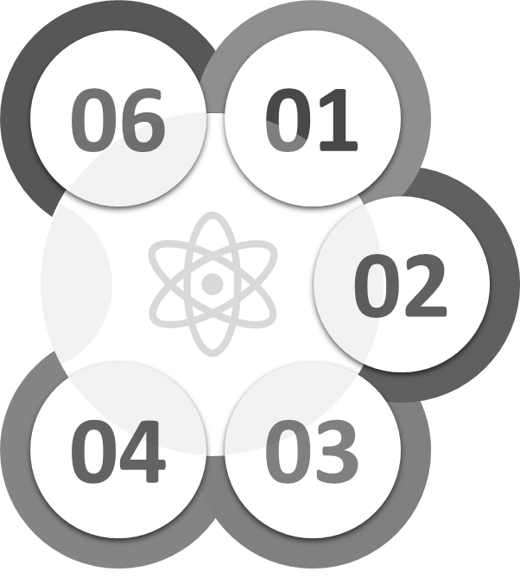
Step 5: Communication
Operation
Discovery
06
01
Communication
05
02
Data Prep
04
03
Model Building
Model Planning
Notes:
Pause for 6 seconds
https://www.presentationgo.com/presentation/cycle-diagram-powerpoint/

Slide 17
“Data are just summaries of thousands of stories – tell a few of those stories to help make the data meaningful.” Chip & Dan Heath, Authors of Made to Stick
In predictive analytics, various algorithms are deployed to mine data to find patterns with the goal making predictions.
Predictive analytics systems deploy more complex algorithms and are more computationally intensive
In Predictive Analytics systems the focus is in predicting the future as opposed to describing what has happened in the past which is the focous of BI systems.
Notes:
Pause for 15 seconds.

Slide 18
Step 5: Communicating Results
Clearly articulate the methodology at an appropriate technical level according to the audience
Interpret results
Explain key findings
Quantify business value
Make recommendations for future work or improvements to existing processes
Notes:
After the model is finalized, you need to clearly communicate the results and insights of the model to the relevant stakeholders. In doing so, you need to explain the implication of the results in business terms and to quantify how the model insights can improve the business.
You should understand that the management and key decision makers are more interested in understanding the business implications of your model rather than the technical details. You should also be able to provide your recommendation based on the modeling results.

Slide 19
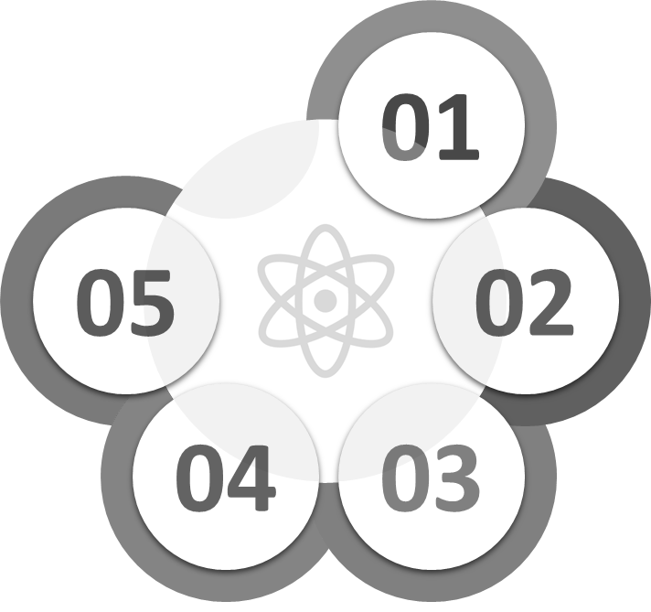
Step 6: Operation
Operation
Discovery
06
01
Communication
05
02
Data Prep
04
03
Model Building
Model Planning
Notes:
Pause for 6 seconds
https://www.presentationgo.com/presentation/cycle-diagram-powerpoint/

Slide 20
“The value of an idea lies in the using of it.” Thomas A. Edison
In predictive analytics, various algorithms are deployed to mine data to find patterns with the goal making predictions.
Predictive analytics systems deploy more complex algorithms and are more computationally intensive
In Predictive Analytics systems the focus is in predicting the future as opposed to describing what has happened in the past which is the focous of BI systems.
Notes:
Pause for 8 seconds

Slide 21
Step 6: Operationalize the Model
Deliver technical documentation of the model and data
Provide consultancy and support for best way to operationalize the model
Define test cases and assure correct procedures are followed for operationalizing the model
Define the processes to retain and update the models.
Notes:
After the presenting the results of your model, you need to help the organization to implement the model.
For that, you would need to deliver documentation which describes in details the steps for building the model that also includes how the data sources should be accessed and prepared.
You may also need to define test cases to validate the model implementation in the production environment. Many models may need to be updated over the time. If that’s the case, you would need to define the steps required for re-calibration of the model.

Slide 22
Quiz
Which of the followings is the most time consuming and iterative step in the cycle of an analytics project?
Model Building
Model Planning
Data Preparation
None of the above
(Correct answer is C)

